Slide 1
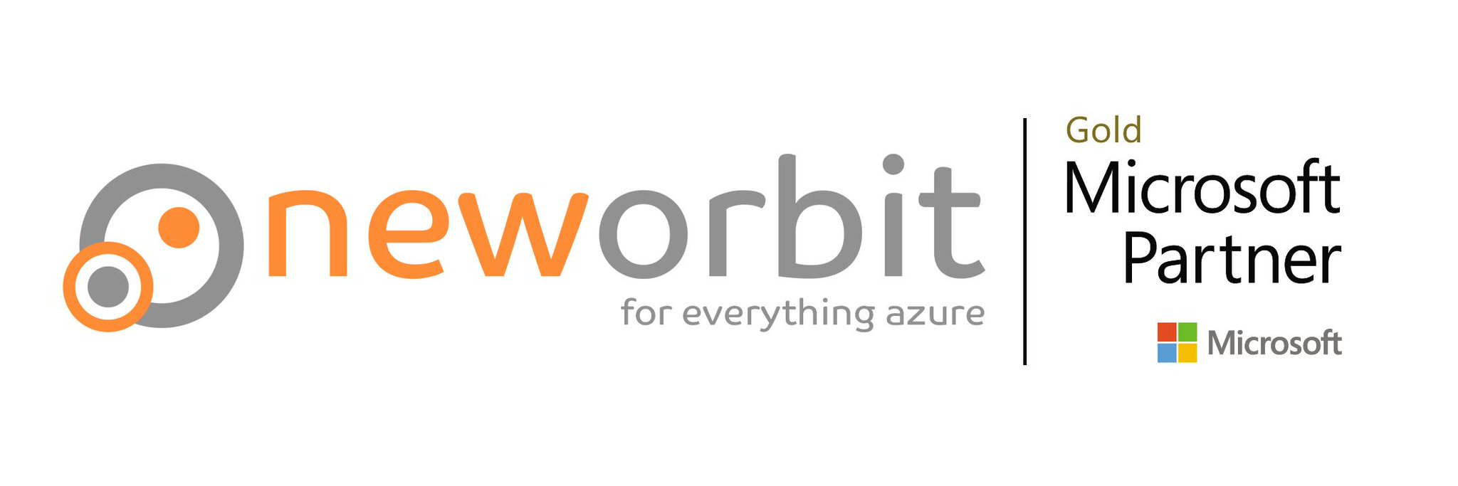
Azure Key Vault

Slide 2

What is Azure Key Vault?
Secrets
Safe place to store passwords
Keys / Cryptography
Public/Private key encryption
Certificate Store
Safe place to store X509 certificates
Storage Account key rotation
Bonus: CosmosDB key rotation
You have to write it yourself
Notes:
I will focus on the first two today and just give you a very short intro to the others.

Slide 3
Secrets
Subtitle

Slide 4
Storing Secrets
In source
You’re fired
In web.config or equivalent
Need to encrypt and then you need to handle the key for that
In Azure App Settings or similar
Who can read those settings?
In CD pipeline
But where does it write to? Can someone read it there?

Slide 5
Storing secrets in Key Vault
Store and retrieve secrets
Fine-grained access control
For example, write-only access to a user, read-only access to an app
Auth is easy with Managed Identity
Store multiple versions with stop/start dates etc
The dates are advisory and your code has to decide whether to read and use them
Uniquely reference specific versions

Slide 6
DEMO
Secrets
Notes:
I am going to use az cli for this because it’s much faster than going through the portal.

Slide 7

Managed Identity
Notes:
Creates a service principal (i..e. user) for your Azure Service and the code you saw will automatically use. Just remember to give it the correct rights to your key vault.

Slide 8
Keys / Cryptography
Encryption and Signing

Slide 9

Encryption
Symmetric keys
Fast
Can encrypt large amounts of data
Asymmetric keys
Anything encrypted with the public key can only be decrypted with the private key – and vice-versa
RSA is public/private keys
Is the heart of X509 certificates
Can only encrypt very small pieces of data (few hundred bytes)
Key Vault (currently) only supports asymmetric keys
RSA and Ecliptic Curve
Software or HSM
The private key can never be extracted from the Key Vault (this is good)
This Photo by Unknown Author is licensed under CC BY-NC

Slide 10
Encryption with asymmetric keys
Generate a random, single-use symmetric key
Encrypt your content with that symmetric key
Encrypt the symmetric key with your public key
Store the encrypted symmetric key, the Initialisation Vector, the version of the asymmetric key and the encrypted content together.
You can concatenate the byte arrays
You can store the extra bits in meta data; look at how Microsoft implemented client-side encryption for Blob Storage.
Change the asymmetric key regularly
Notes:
Why bother?
You are not storing the encryption anywhere where anyone can get it! The private key cannot be extracted from key vault.
If you use one symmetric key, it becomes easier to figure out the key – and then everything can be decrypted.
It’s harder to crack the asymmetric keys – and you change even those regularly.

Slide 11
Signing with Key Vault
Create a SHA512 HASH of the content
Encrypt it with the private key (Azure Key Vault does that for you)
Anyone (including you) can try to decrypt it with the Public key (Key vault can do that for you too) and, if the decrypted HASH matches then you know it has not been tampered with.

Slide 12
DEMO
Keys / Cryptography
Notes:
I am going to use az cli for this because it’s much faster than going through the portal.

Slide 13
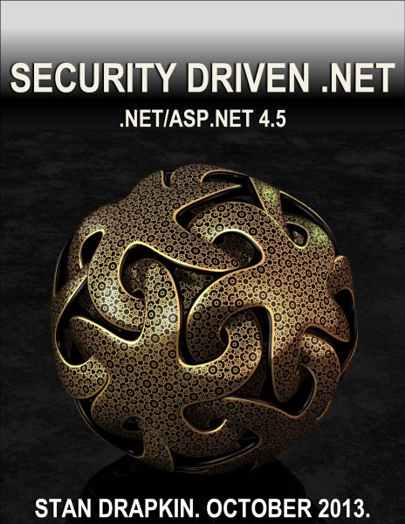

Slide 14
The Rest

Slide 15
The Rest
Certificate Store
Safe place to store X509 certificates
Storage Account key rotation
Baked in – but recommended you use AD auth instead now
Bonus: CosmosDB key rotation
You have to write it yourself

Slide 16

What Questions do you have?

